Slide 1
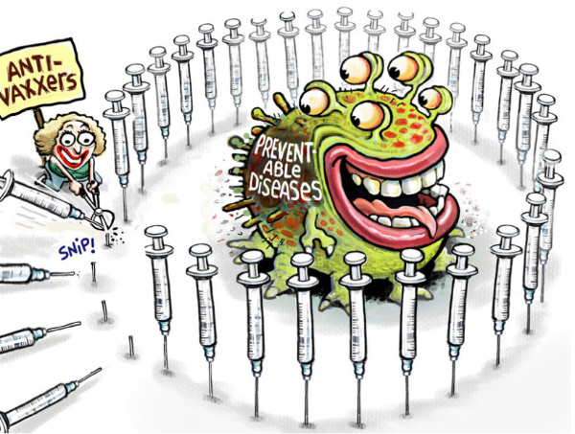
Analysis of
Disease
Outbreaks
Group 23
Ram Dyuthi Sristi
Xintong Zhou
Jiawei Yin
Yidong Li

Slide 2

Content
Motivation
Data Overview
Ebola
Poilo
H1N1
Brief Disease Comparison
Season
Population
Flights
Vaccine
Case Study: H1N1
Conclusion

Slide 3

Motivation
The recent coronavirus (COVID-19) outbreak
Commonality among diseases
Possible factors affecting the spread

Slide 4

Data Overview
Ebola Cases Data
Polio Cases Data
H1N1 Cases Data
Population Data
Flight Data

Slide 5
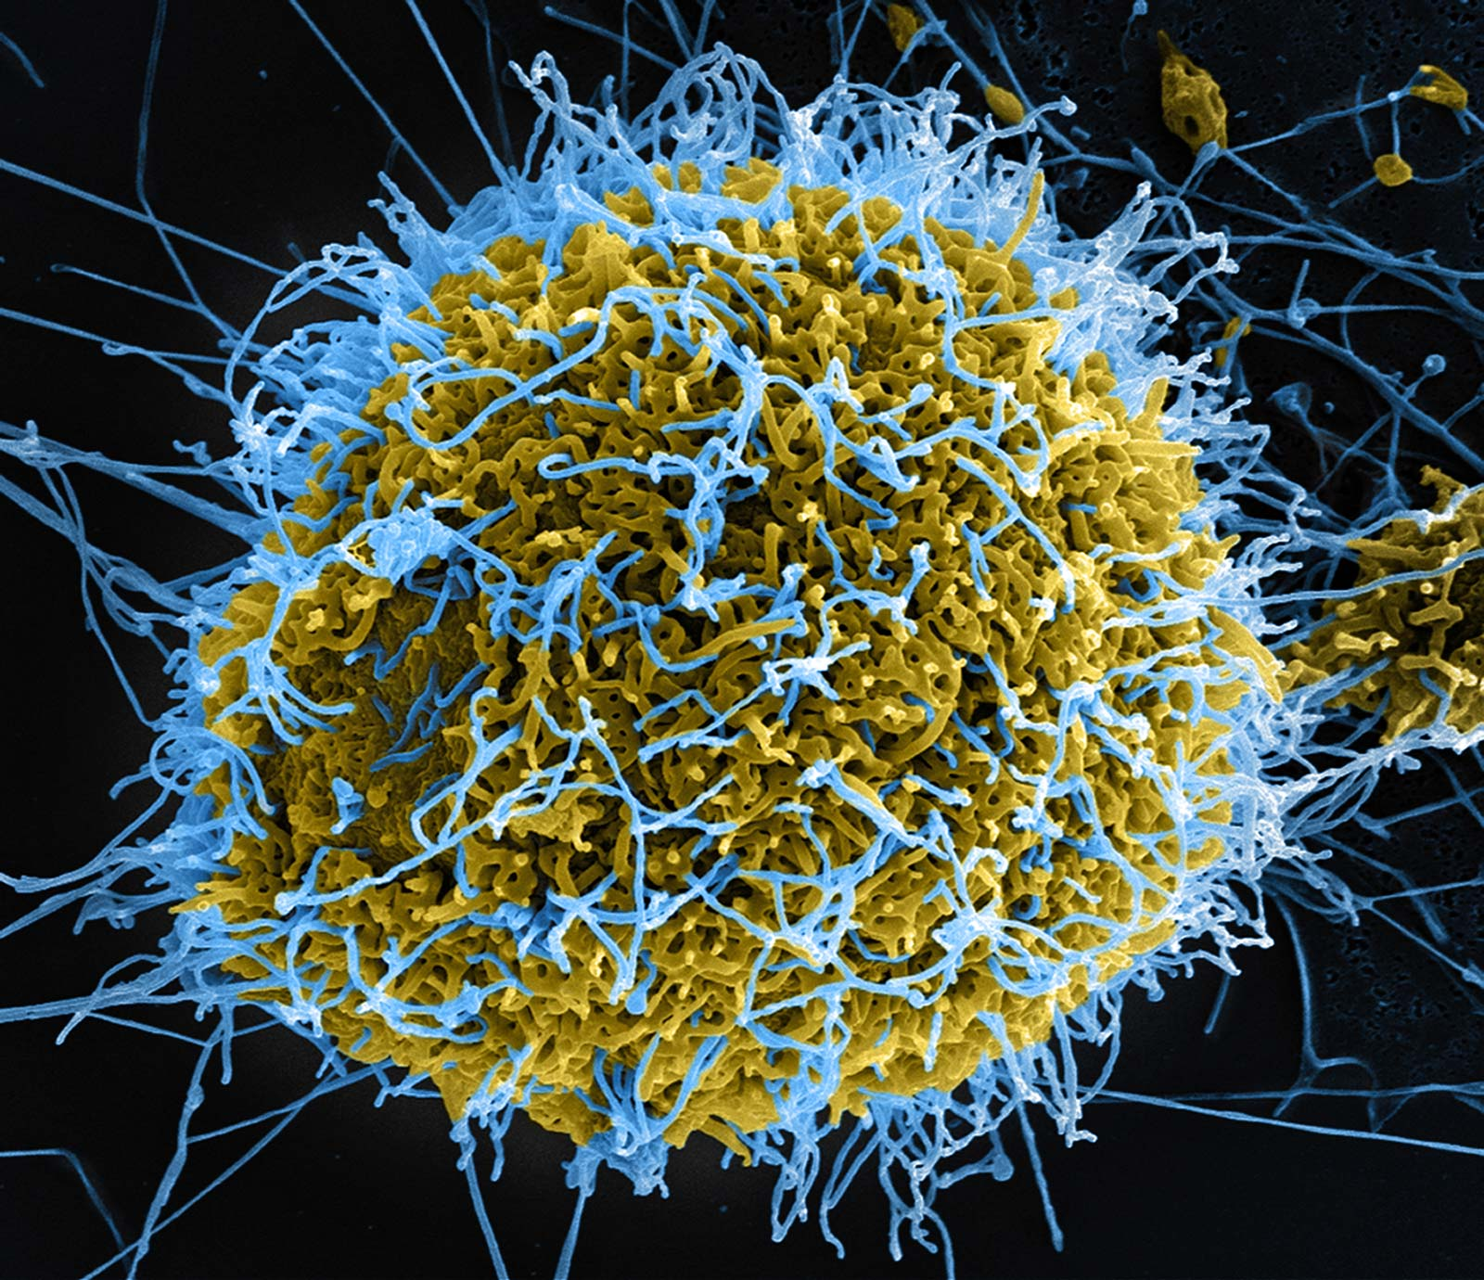
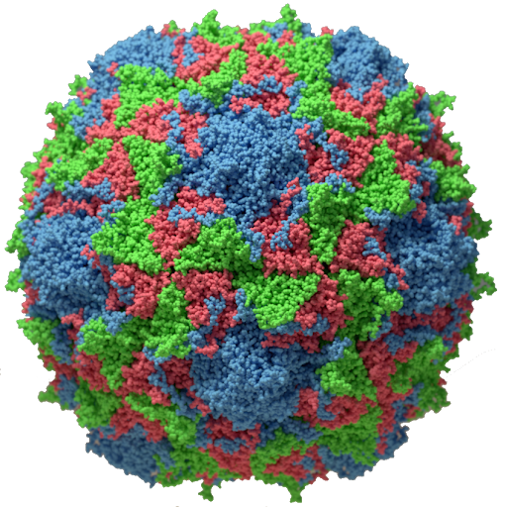

Brief Disease Comparison
Ebola
Polio
H1N1

Slide 6
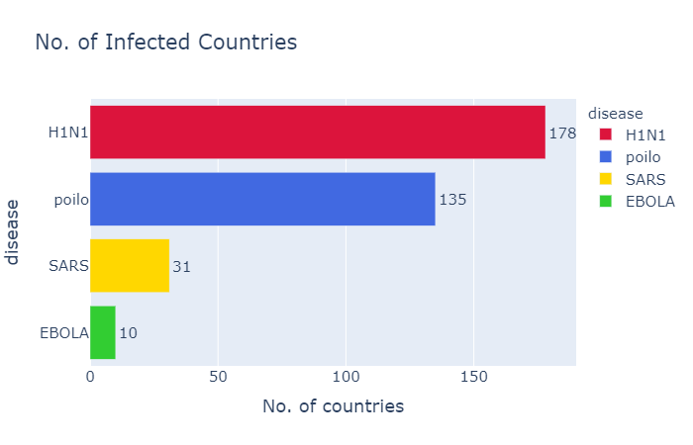

Slide 7
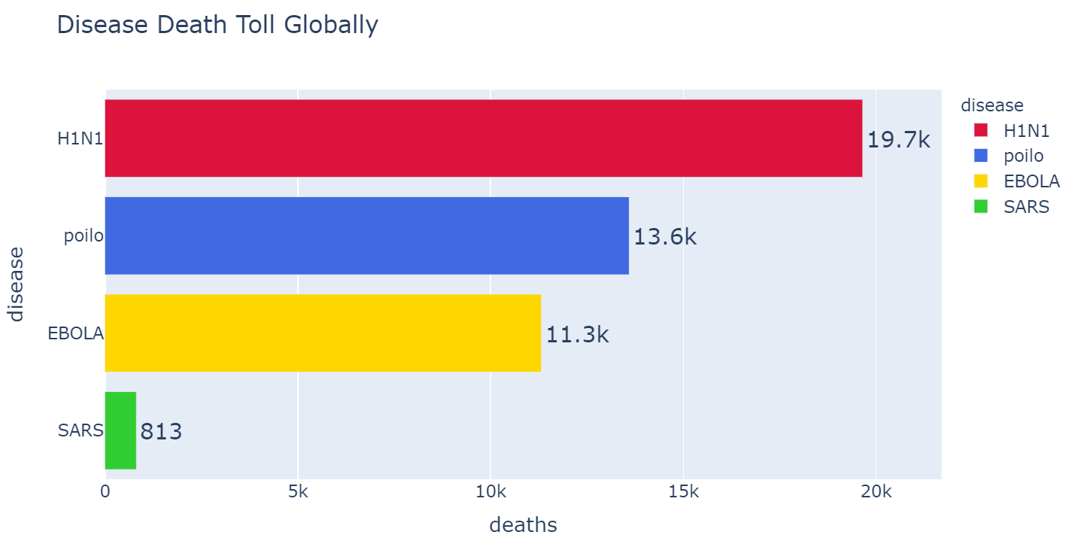
(0.01%~0.08%)
2.5%, child 22.5%,adult
(50%)
(11%)

Slide 8
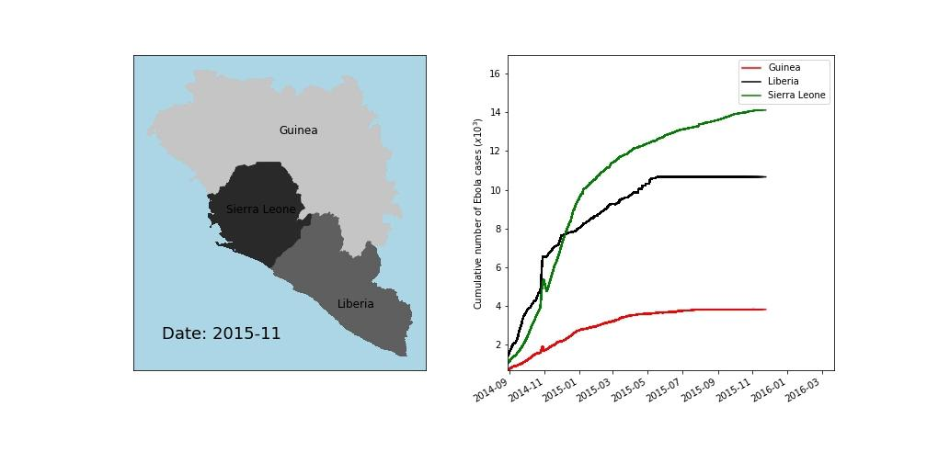
Ebola - Spread

Slide 9
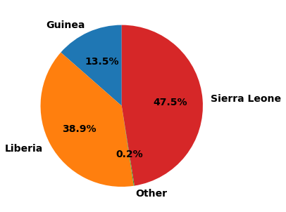
Ebola
No. of Confirmed cases
Three countries in Africa are majorly affected
Spread to the other parts is minimal

Slide 10
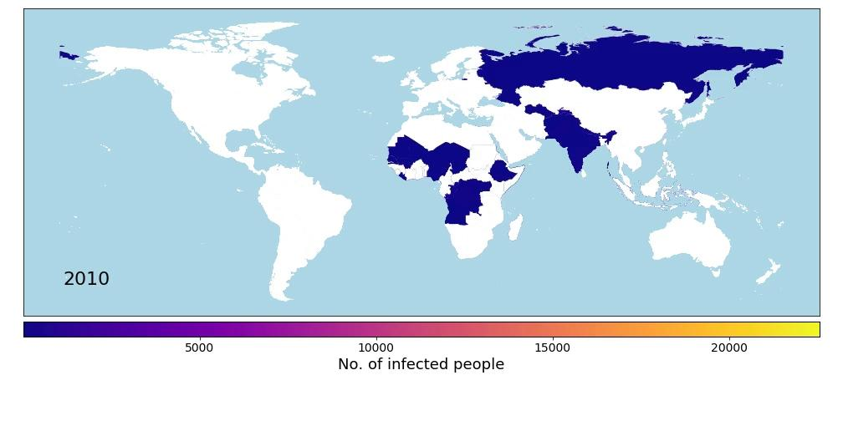
Polio - Spread

Slide 11
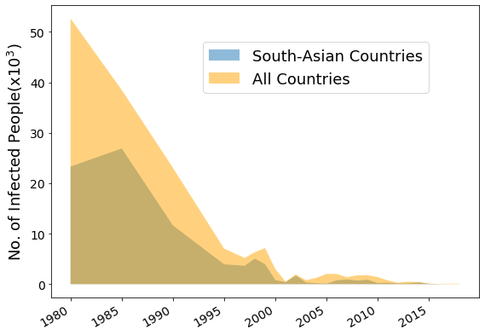
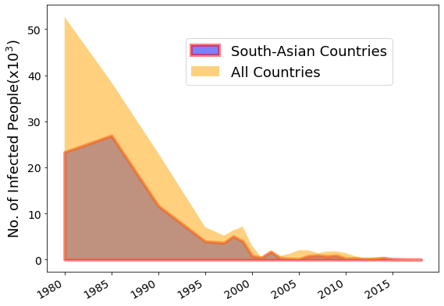
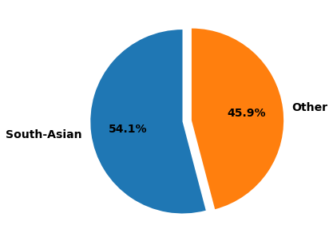
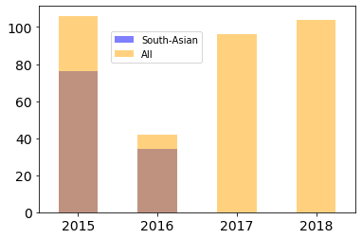
Polio - Affected Countries
South-Asian Countries are majorly affected.
Polio is almost eradicated
South-Asian Countries are majorly affected.
Polio is almost eradicated
South-Asian Countries are majorly affected.
Polio is almost eradicated

Slide 12

Kudos to!

Slide 13
Case Study: H1N1

Slide 14
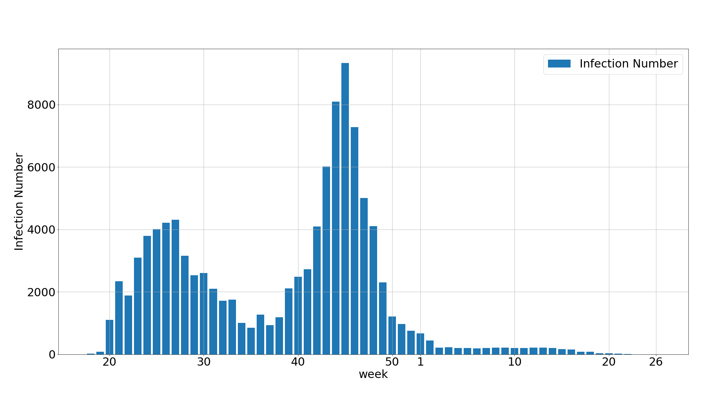
Case Study: H1N1 - Timeline
May
Mid Jun
Oct
Dec
Apr 15th
2010
End of June
1st Peak
2nd Peak
San Diego

Slide 15
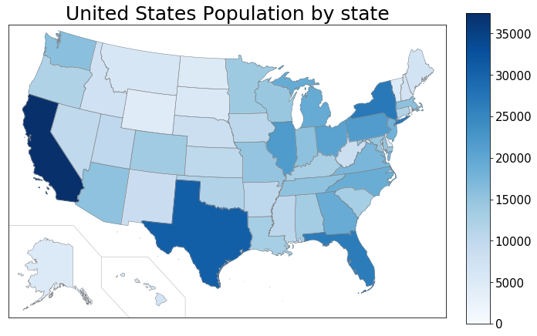
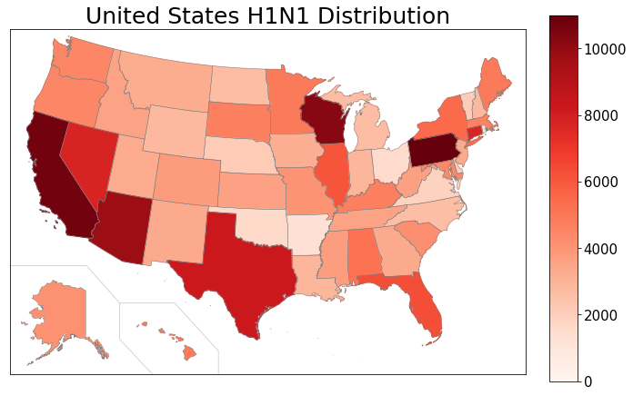
Case Study: H1N1 – Population Factor
population number
(units: ten thousand)
number of infected persons

Slide 16
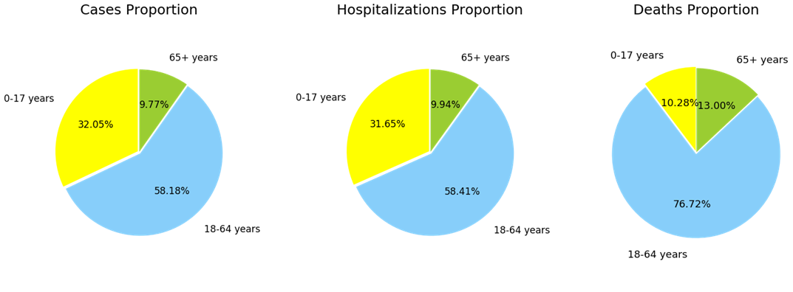
Case Study: H1N1 – Age Group
Age Group | Lethality Rate
0 – 17 years | 0.006%
18 – 64 years | 0.027%
65+ years | 0.027%

Slide 17
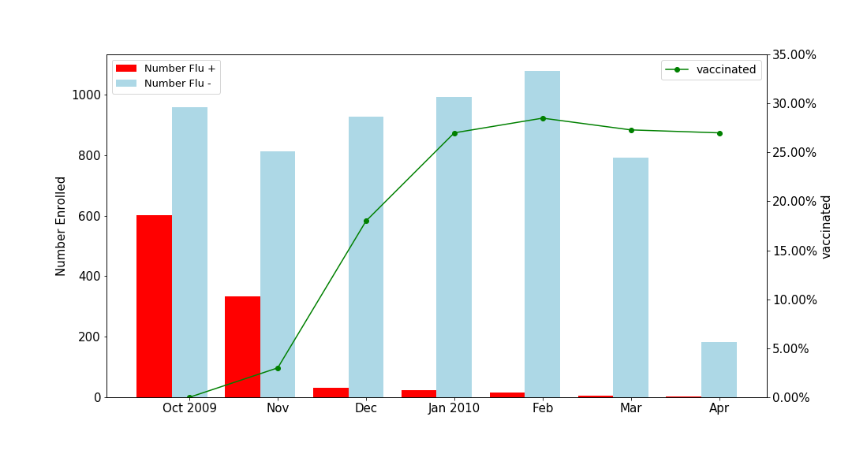
Case Study: H1N1 – Vaccine

Slide 18
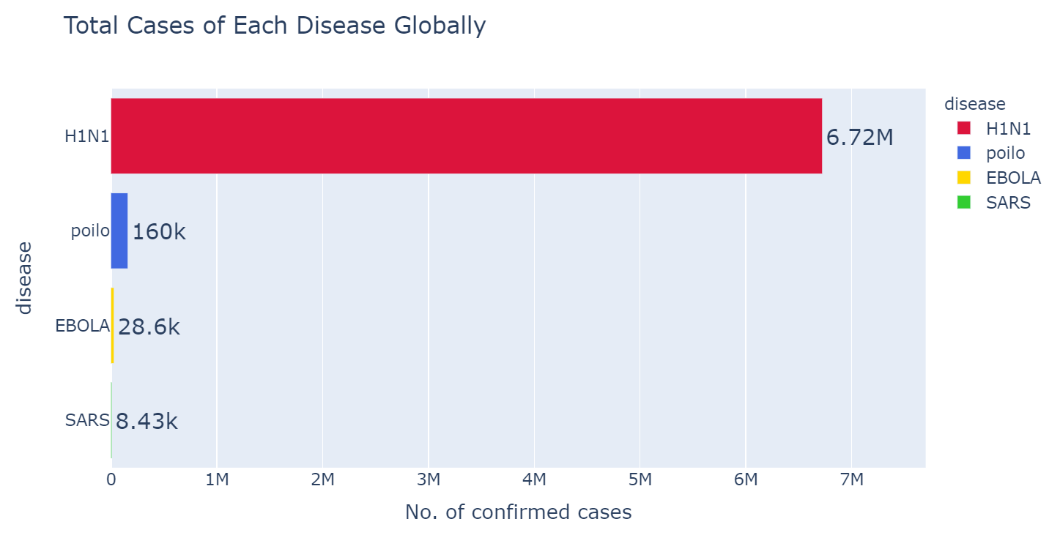

Slide 19
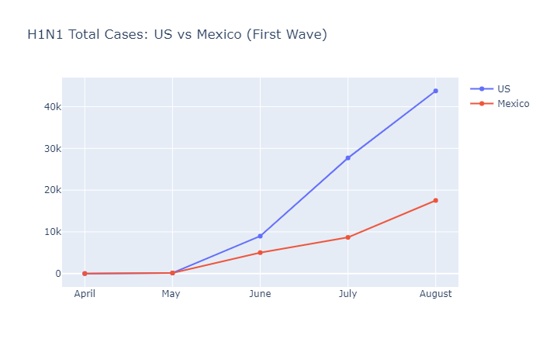
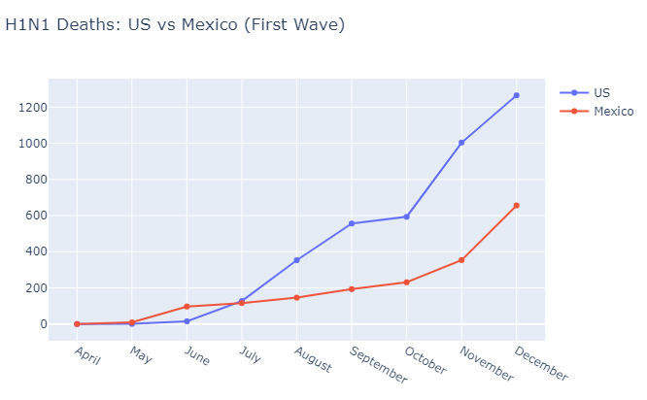
Case Study: H1N1 - Mexico vs U.S
Increase speed: U.S > Mexico
Cases: U.S > Mexico
Deaths: U.S > Mexico

Slide 20
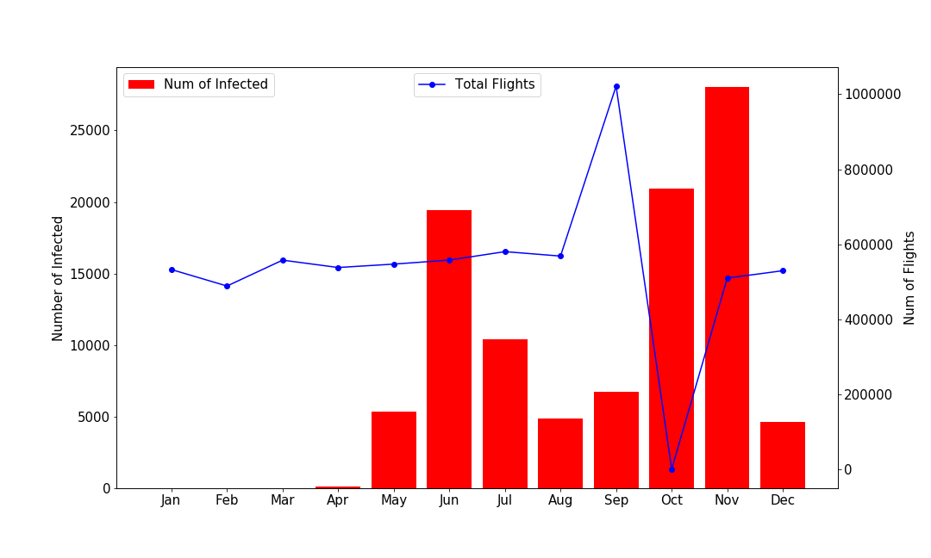
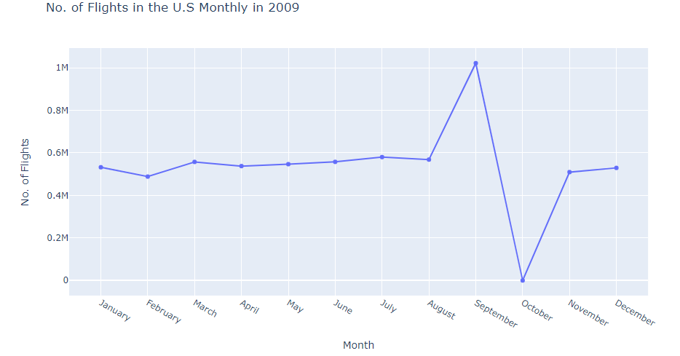

Case Study: H1N1 - Flights vs Cases

Slide 21
“With respect to closing the border, again, you would close the border if you thought you could contain disease, the spread of disease. But the disease already is in a number of states within the United States. So the containment issue doesn't really play out.”
-Janet Napolitano U.S Secretary of Homeland Security, April 27th, 2009 Press Conference

Slide 22
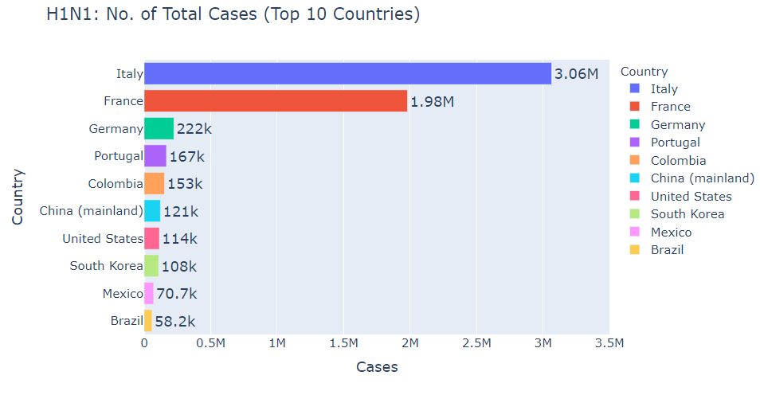

Top 5
57M
population 2009:
U.S: 306M
Mexico: 115M

Slide 23
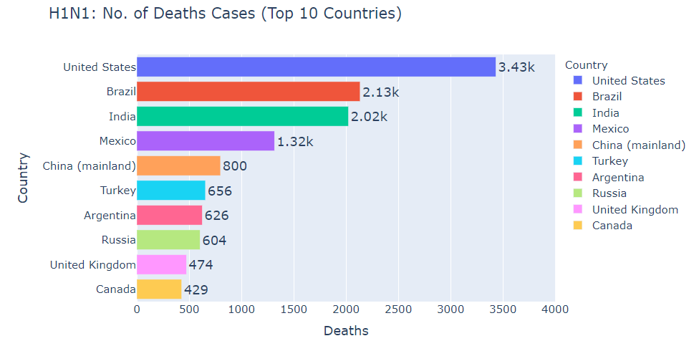
11k
Mexico:
Distributed 6M masks to citizens
U.S:
No masks needed

Slide 24
Conclusion
Commonality - Neighbour countries
Factors:
Season - influence the spread rate
Population: directly proportional to spread (exceptions exist)
Age: the aged people are much easier to get infected
Vaccine: is extremely effective

Slide 25
Thank you!

Slide 26
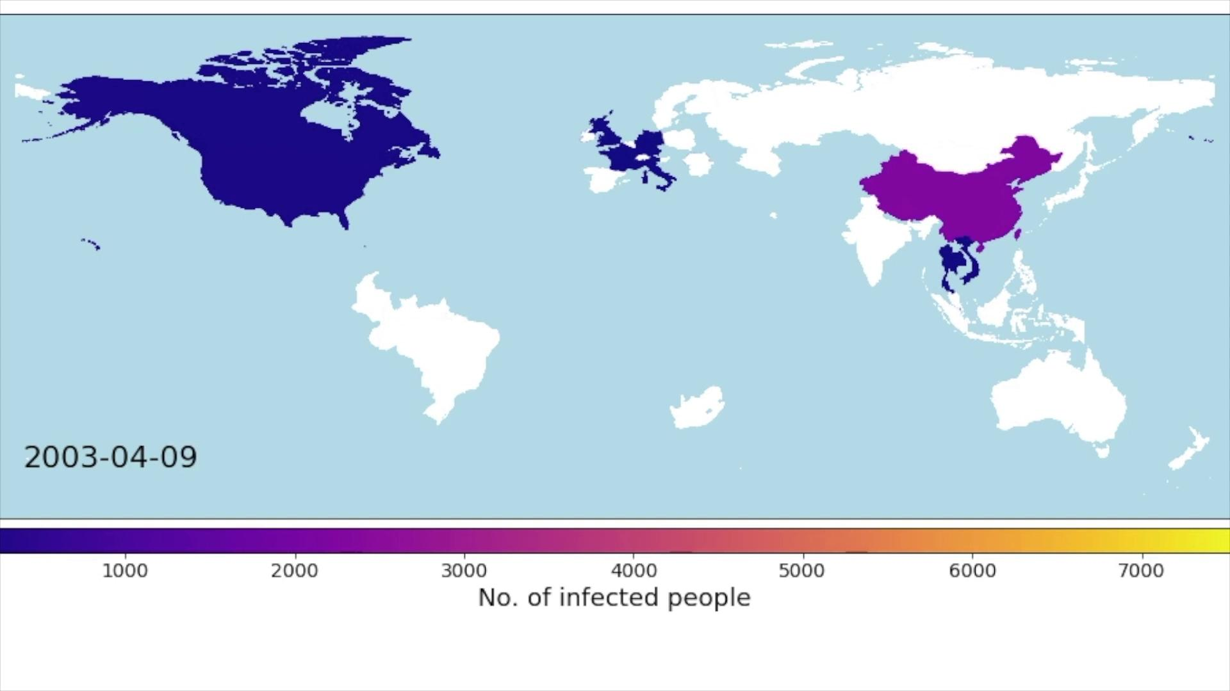
Sars

Slide 27
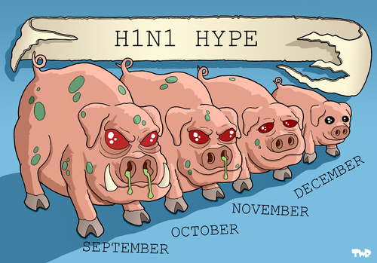
Case Study: H1N1 - Seasonality

